Slide 1
Spectrum Deconvolution
Determination Of Different Radionuclides in a Mixture
Eric Einspänner

Slide 2
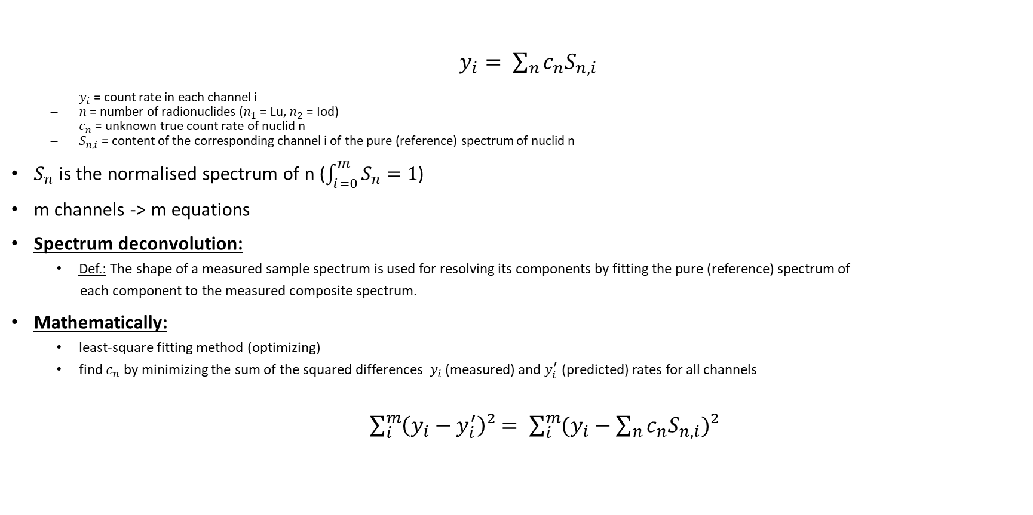
Spectrum deconvolution
$y_{i}= \sum_{n}{c_{n}S_{n,i}}$
$y_{i}$ = count rate in each channel i
$n$ = number of radionuclides ($n_{1}$ = Lu, $n_{2}$ = Iod)
$c_{n}$ = unknown true count rate of nuclid n
$S_{n,i}$ = content of the corresponding channel i of the pure (reference) spectrum of nuclid n
$S_{n}$ is the normalised spectrum of n ($\int_{i=0}^{m}{S_{n}=1}$)
m channels -> m equations
Spectrum deconvolution:
Def.: The shape of a measured sample spectrum is used for resolving its components by fitting the pure (reference) spectrum of
each component to the measured composite spectrum.
Mathematically:
least-square fitting method (optimizing)
find $c_{n}$ by minimizing the sum of the squared differences $y_{i}$ (measured) and $y_{i}^{′}$ (predicted) rates for all channels
$\sum_{i}^{m}{\left(y_{i}−y_{i}^{′}\right)²}= \sum_{i}^{m}{(y_{i}−\sum_{n}{c_{n}S_{n,i}})²}$

Slide 3
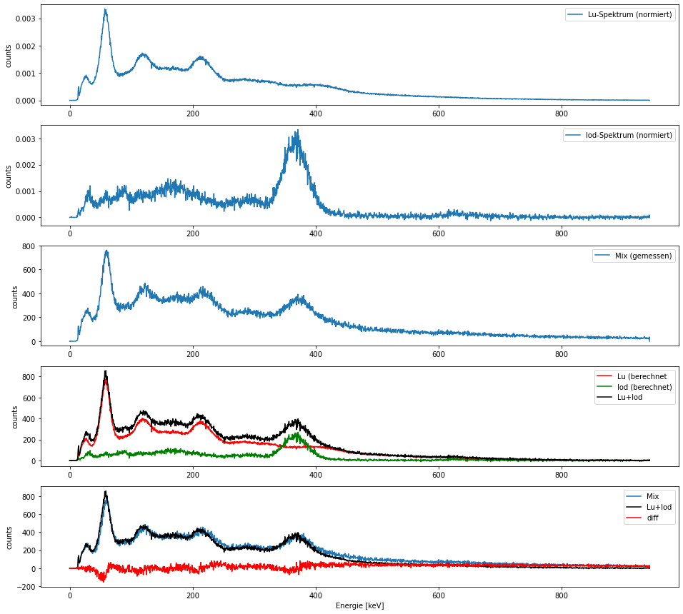


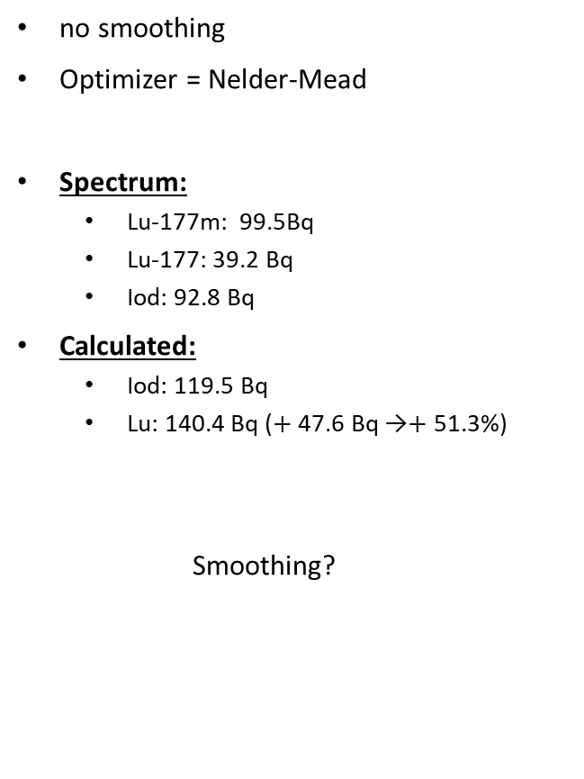





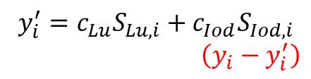
no smoothing
Optimizer = Nelder-Mead
Spectrum:
Lu-177m: 99.5Bq
Lu-177: 39.2 Bq
Iod: 92.8 Bq
Calculated:
Iod: 119.5 Bq
Lu: 140.4 Bq ($+$ 47.6 Bq →$+$ 51.3%)
Smoothing?
$$S_{Lu,i}$$
$$S_{Iod,i}$$
$$y_{i}$$
$$c_{Lu}S_{Lu, i}$$
$$c_{Iod}S_{Iod, i}$$
$$y_{i}^{′}$$
$$R^{2}=0.94$$
$$y_{i}^{′}=c_{Lu}S_{Lu, i}+c_{Iod}S_{Iod, i}$$
$$\left(y_{i}−y_{i}^{′}\right)$$

Slide 4
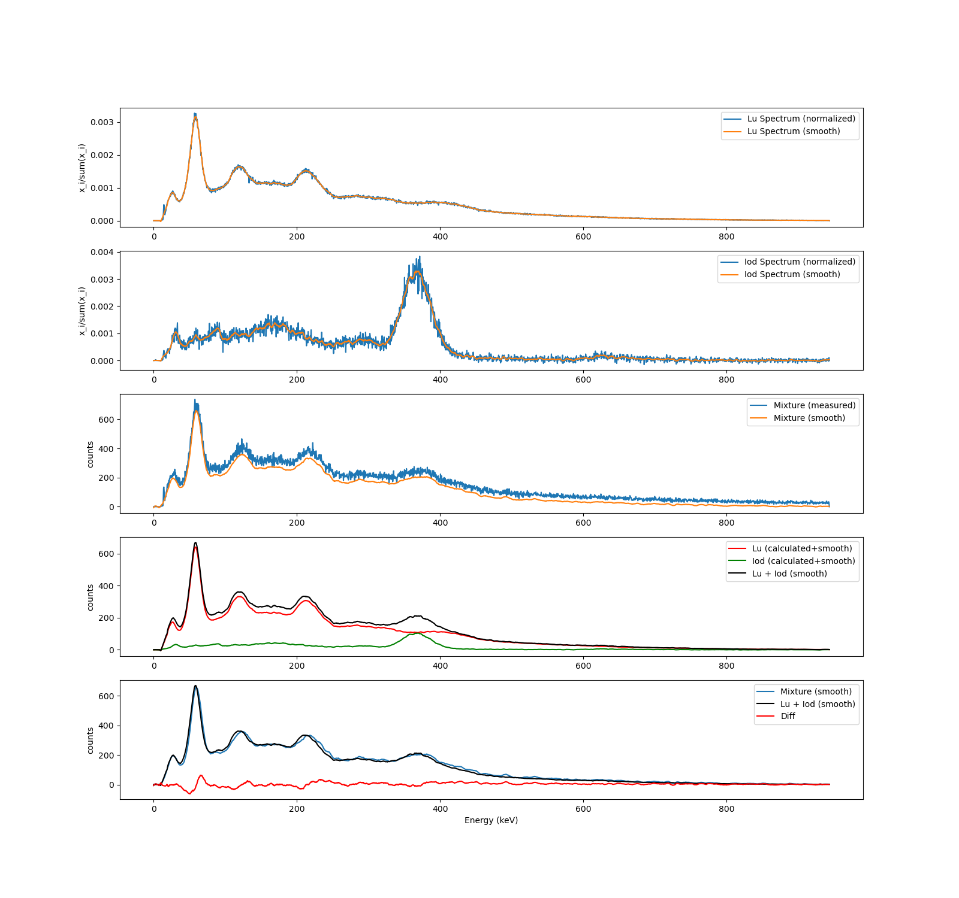
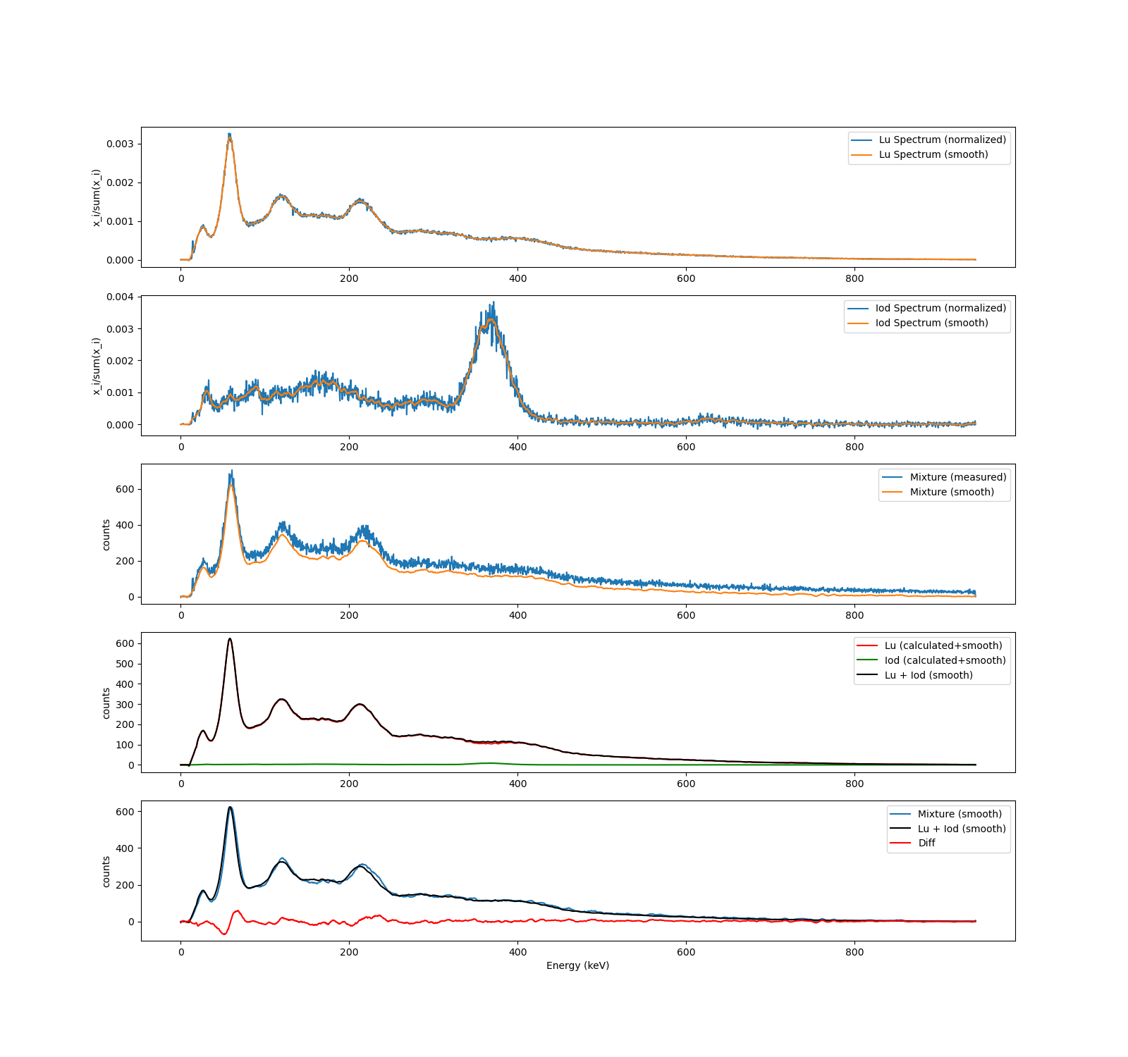
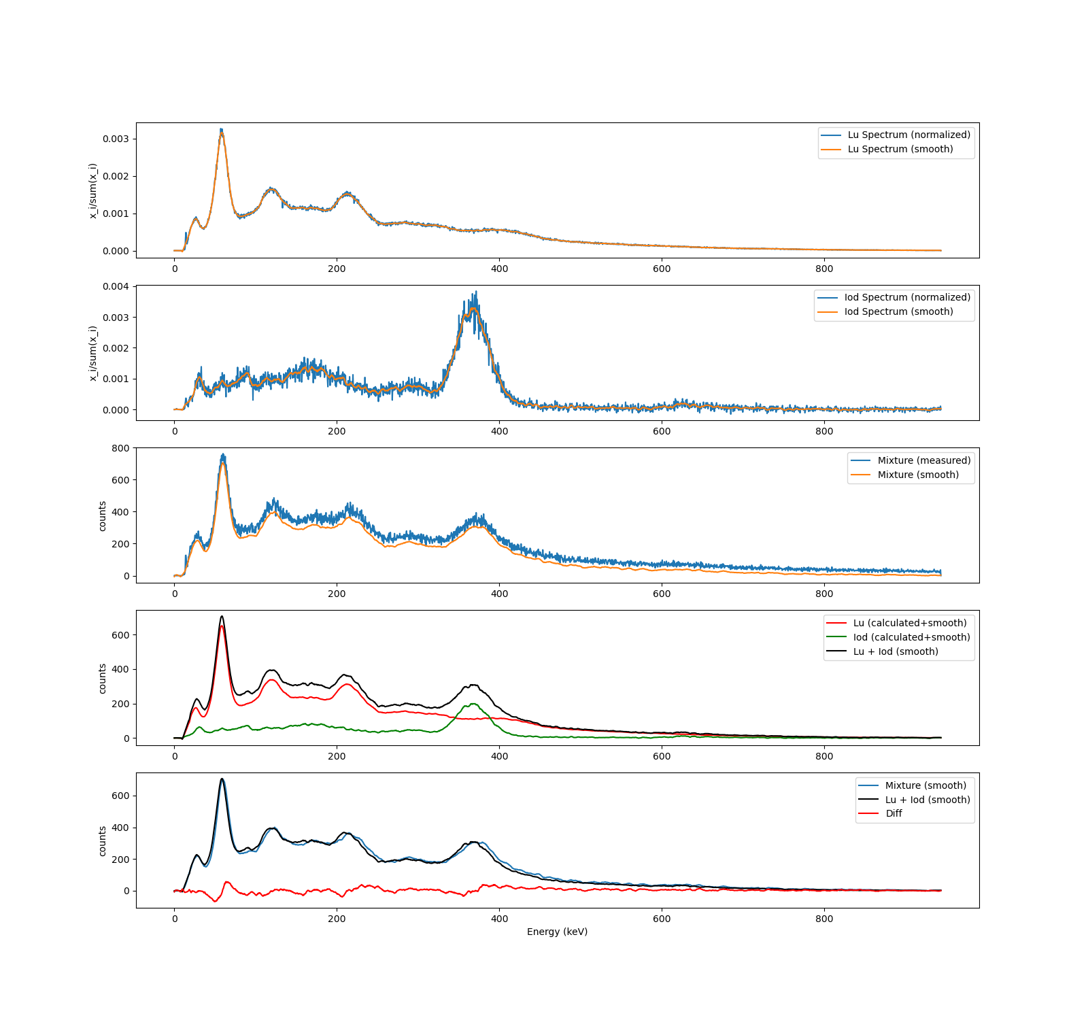
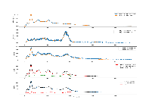
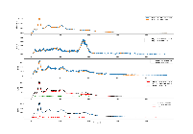
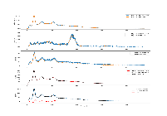

Savitzky-Golay filter for smoothing
Optimizer = Nelder-Mead
1. Mixture:
$R^{2}=0.988$
Real:
Lu-177m: 99.5Bq
Lu-177: 39.2 Bq
Iod: 92.8 Bq
Calculated:
Lu-177m : 106.7 Bq
Iod: 103.3 Bq ($+$ 10.5 Bq →$+$11.31%)
2. Mixture:
$R^{2}=0.989$
Real:
Lu-177m: 96.4 Bq
Lu-177: 37.8
Iod: 46.2 Bq
Calculated:
Lu-177m : 101.8 Bq
Iod: 55.6 Bq ($+$ 9.4 Bq →$+$20.35%)
3. Mixture:
$R^{2}=0.988$
Real:
Lu-177m: 86.2 Bq
Lu-177: 33.6 Bq
Iod: 4.6 Bq
Calculated:
Lu-177m : 98.7 Bq
Iod: 4.6 Bq ($±$0 Bq →$+$0%)

Slide 5
How good is Spectrum deconvolution?
Advantages
Disadvantages
only one measurement necessary for activity determination
additional nuclides can be added
General: easy adaptation to similar use cases
results can be further improved, if necessary, by adjusting the parameters
fast and smart ;)
various factors have an influence on the result
data quality
smoothing filter
optimizer
…
results only with smoothing filter with small errors
co-existence of Lu-177m and Lu-177 not considered.

